Slide 1







Running with Tiny bit
Control speed
Yahboom

Slide 2







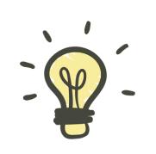
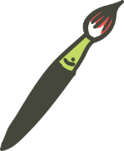
Contents
Preparation
Learning goal
Search for blocks
Combine blocks
Experimental phenomena
Yahboom

Slide 3

Preparation
The position of the motor on the robot car
Programming method:
Mode 1 online programming: First, we need to connect the micro:bit to the computer by USB cable. The computer will pop up a USB flash drive and click on the URL in the USB flash drive: http://microbit.org/ to enter the programming interface. Add the Yahboom package: https://github.com/YahboomTechnology/Tiny-bitLib to program.
Mode 2 offline programming: We need to open the offline programming software. After the installation is complete, enter the programming interface, click【New Project】, add Yahboom package: https://github.com/YahboomTechnology/Tiny-bitLib, you can program.
Yahboom

Slide 4
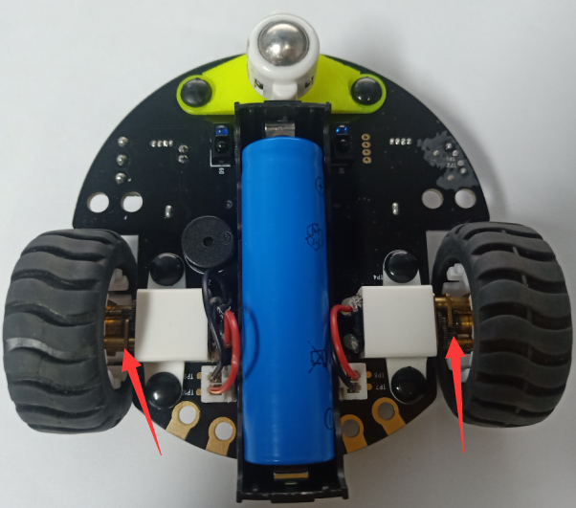
Preparation
As shown in the figure below, the red arrow points to the Tiny-bit motor.
Yahboom

Slide 5
Learning goal
1.Learn how to use control motor graphically program building blocks
2.In this lesson, we will learn how to control speed of motor
Yahboom

Slide 6

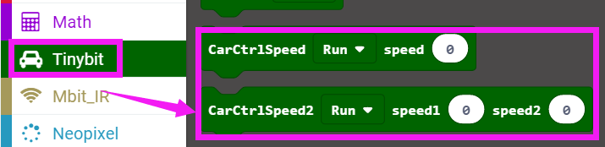
Search for block
The following is the location of the building blocks required for this programming.
Yahboom

Slide 7
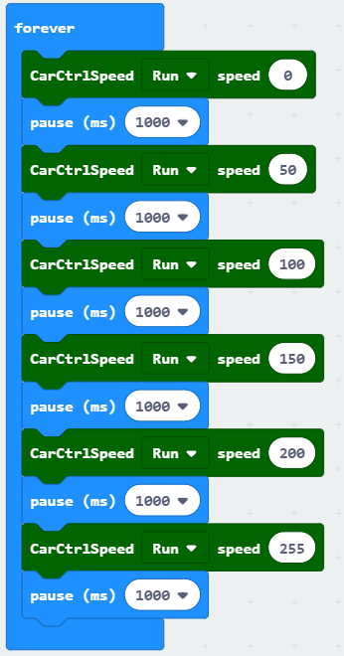
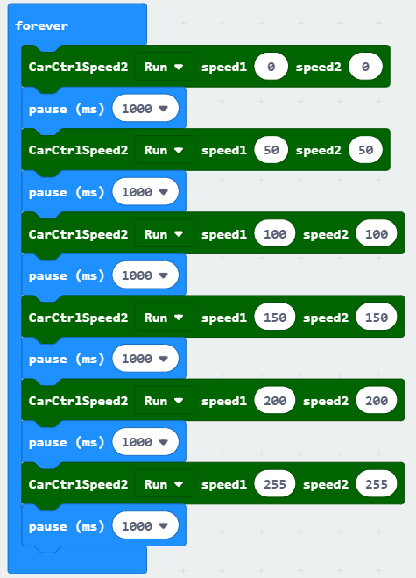
Combine block
The summary program is shown below:
Method 1：
Method 2：
Yahboom

Slide 8
Experimental phenomena
After program is downloaded, we can see that robot car will advance with different speed.
Yahboom

Slide 9
Inspire Creativity Embrace Innovation
Thank you!!!

